Slide 1
MACHINE LEARNING -ASSIGNMENT 1 Google Colab Link: https://colab.research.google.com/drive/1q94dreHO3hRhdrzIrbMCtp_BvvxPnM5U?usp=sharing
PAVITRA ANKESH
CSE- 5D
ENG19CS0221

Slide 2
CONTENTS
Introduction to Artificial Intelligence
Introduction to Machine Learning
Introduction to Data Warehousing and Data Mining
Classification of Machine Learning
Supervised Learning
Unsupervised Learning
Reinforcement Learning
Types of Machine Learning Algorithms
Linear Regression
Logistic Regression
Support Vector Machine
Decision Tree
Random Forest
K Nearest Neighbors
Applications of Machine Learning
References

Slide 3
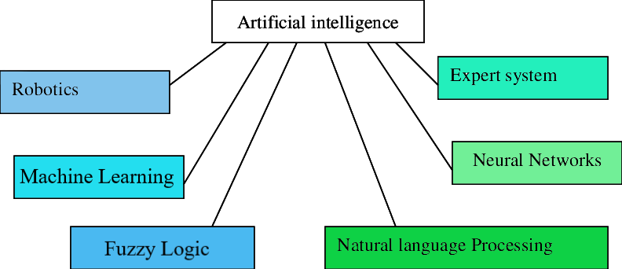
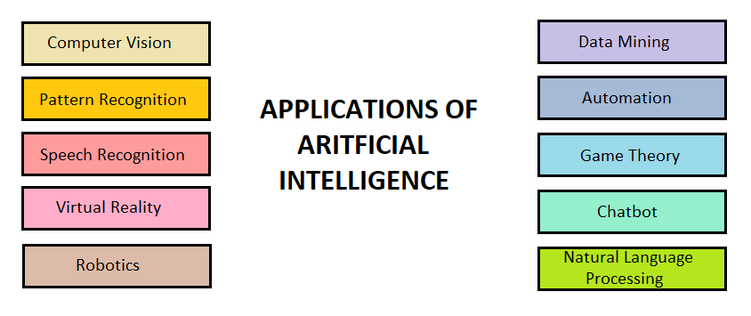

ARTIFICIAL INTELLIGENCE
Artificial intelligence is defined as intelligence exhibited by an artificial entity such as a computer. AI is concerned with producing machines to automate tasks requiring intelligent behavior such as pattern recognition, natural language processing, robotics, computer vision etc.

Slide 4
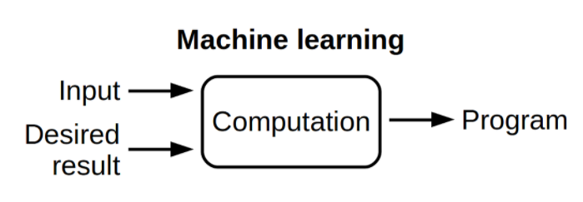
MACHINE LEARNING
Machine learning allows a specific machine to learn itself automatically without any human interaction.
In machine learning, there are specific algorithms that can get data as input, processing data to build a model and predict the output in acceptable range.

Slide 5
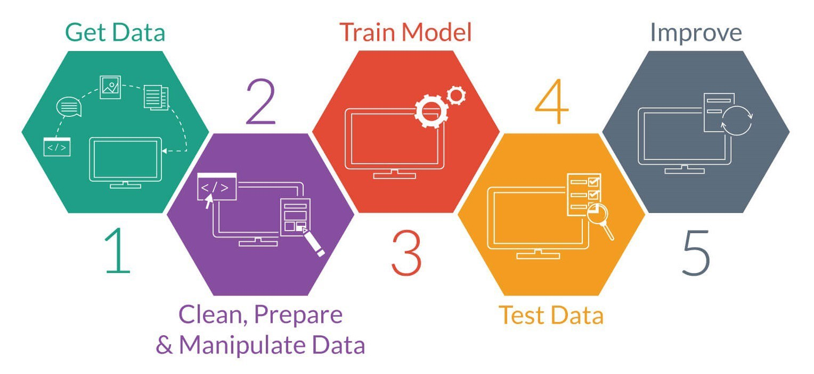
MACHINE LEARNING
MACHINE LEARNING WORKFLOW:

Slide 6
MACHINE LEARNING
MACHINE LEARNING WORKFLOW:
Gather data:
Gathering data involves identifying the sources and aggregate data from those sources into a single dataset.
Data pre-processing:
Pre-processing involves cleaning, verifying, and formatting data into a usable dataset. The pre-processed data is broken into data sets.
Training the model:
Training involves feeding the training set to the algorithm so that it can learn appropriate parameters and features.
Testing:
Testing involves working with the test set which is used to assess the accuracy and performance of the models.
Refinement:
Based on testing, the model can be returned to improve accuracy, adjust output settings, or deploy the model as needed.

Slide 7
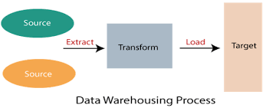
INTRODUCTION TO DATA WAREHOUSING AND DATA MINING
DATA WAREHOUSING:
Data warehousing is a process used to collect and manage data from multiple sources which are used to make decisions.
Data warehouse combines data from numerous sources which ensure the data quality, accuracy, and consistency. Then, the data goes through formatting and import processes to store all the data in a common format. The data warehouse stores this processed data so it’s ready for decision makers to access.

Slide 8
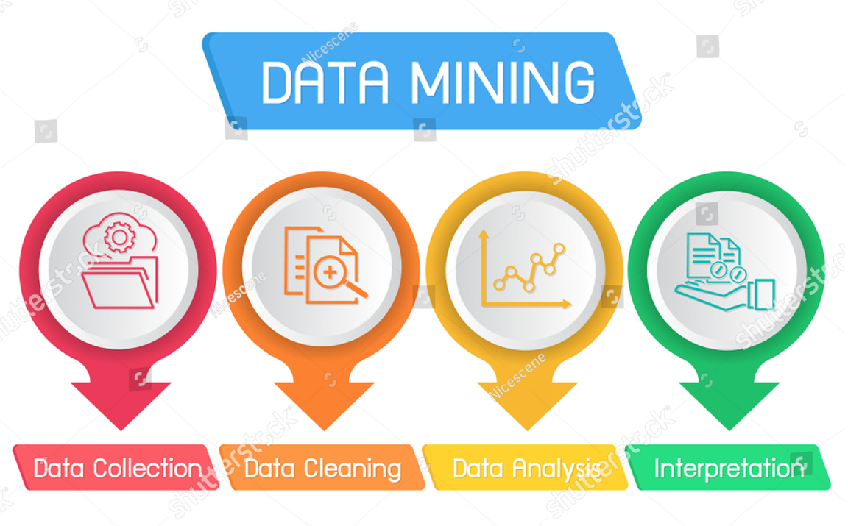
INTRODUCTION TO DATA WAREHOUSING AND DATA MINING
DATA MINING:
Data mining is the process of analyzing massive volumes of data.
Using a range of statistical techniques to analyze data in different ways, users can identify patterns, trends and relationships. They can apply these findings to predict what is likely to happen in the future and take required actions.

Slide 9
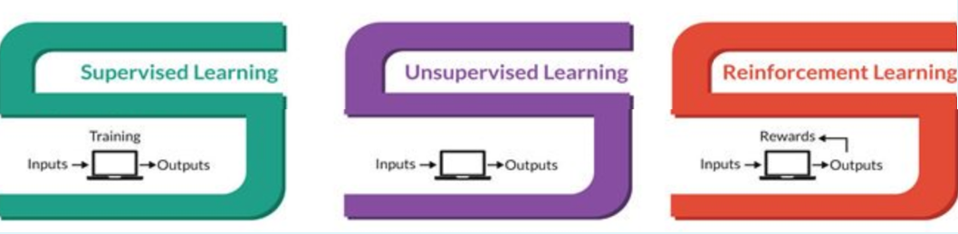
CLASSIFICATION OF MACHINE LEARNING
ML is completely depended on its algorithms. These algorithms can be divided into three classes of learning:
Supervised Learning
Unsupervised Learning
Reinforcement Learning

Slide 10
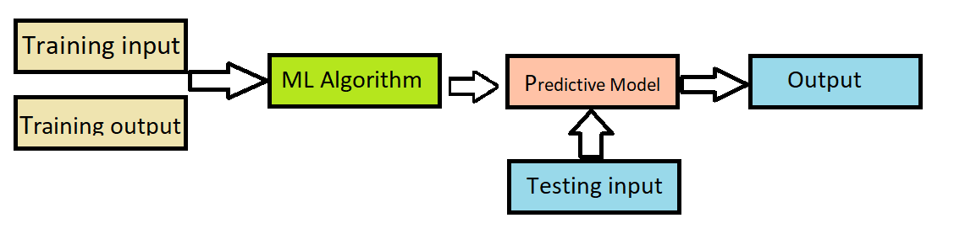
CLASSIFICATION OF MACHINE LEARNING
SUPERVISED LEARNING
In supervised learning, the machine is taught by example or an operator. Here an algorithm is provided with features (inputs) and (outputs). A model is prepared through a training process in which it is required to make predictions and is corrected when those predictions are wrong. The training process continues until the model achieves a desired level of accuracy.

Slide 11
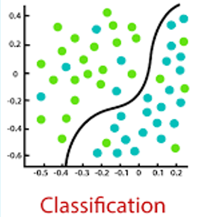
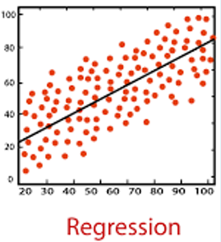
CLASSIFICATION OF MACHINE LEARNING
SUPERVISED LEARNING
Supervised learning algorithms can be either:
Classification:
In classification tasks, the machine learning program must draw a conclusion from observed values and determine to what category new observations belong.
For example, when filtering emails as spam or not spam.
Regression:
In regression tasks, the machine learning algorithm must understand the relationships among variables and continuous data.
For example, predicting the salaries of employees based on experience.

Slide 12
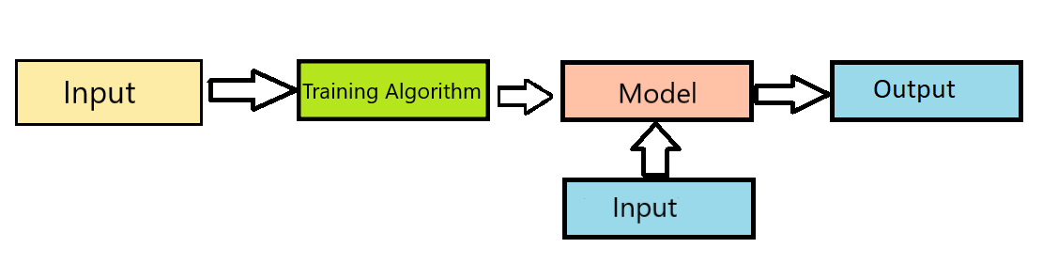
CLASSIFICATION OF MACHINE LEARNING
UNSUPERVISED LEARNING
In unsupervised learning, the machine learning algorithm studies data to identify patterns. Here an algorithm is provided with only features (input). A model is prepared by deducing structures present in the input data.

Slide 13
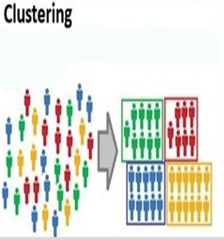
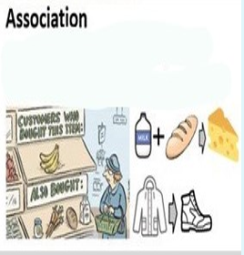
CLASSIFICATION OF MACHINE LEARNING
UNSUPERVISED LEARNING
Unsupervised learning algorithms can be either:
Clustering:
Clustering involves grouping sets of similar data (based on defined criteria). It’s useful for segmenting data into several groups and performing analysis on each data set to find patterns.
For example, distinguishing between fruits and vegetables.
Association:
Association is a technique that checks for the dependency of one data item on another data item and maps accordingly.
For example, associations between items consumers buy at the supermarket.

Slide 14
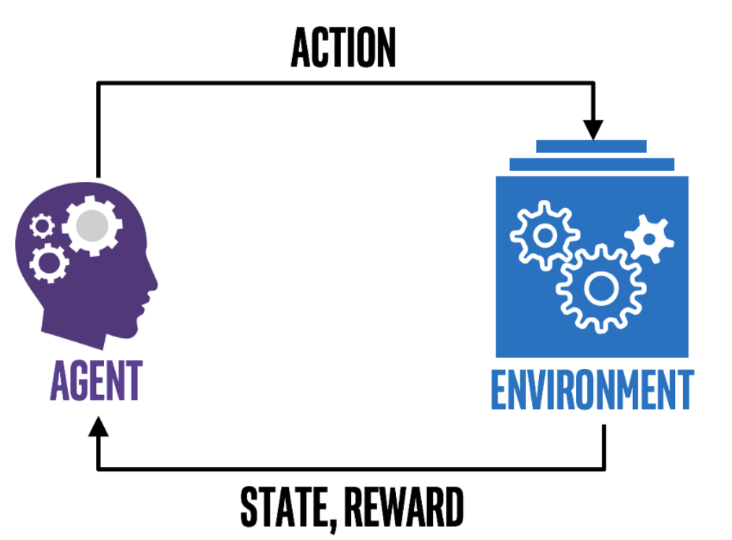
CLASSIFICATION OF MACHINE LEARNING
REINFORCEMENT LEARNING
Reinforcement learning focuses on regimented learning processes, where it algorithm learns from the consequences of an action. Reinforcement learning teaches the machine trial and error using rewards and penalties.
For example, reinforcement learning can be used to train robots.

Slide 15
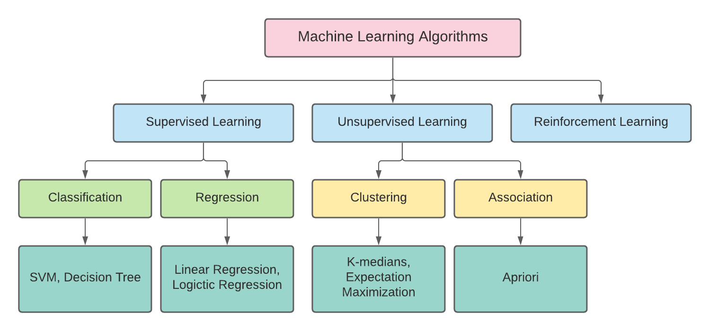
TYPES OF MACHINE LEARNING ALGORITHM
The most commonly used machine learning algorithms are:
Linear Regression
Logistic Regression
Support Vector Machine
Decision Tree
Random Forest
K Nearest Neighbors

Slide 16
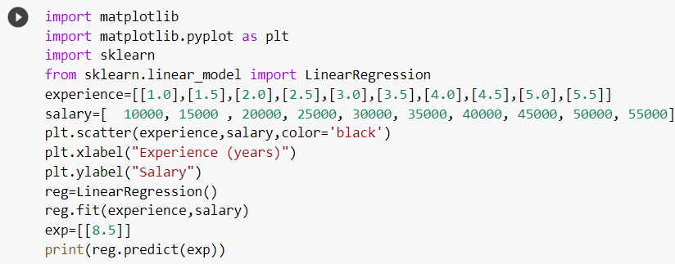
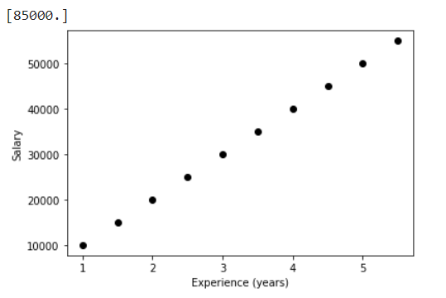
LINEAR REGRESSION
TYPES OF MACHINE LEARNING ALGORITHM
Linear regression is a supervised learning algorithm. In linear regression, value of dependent variable is predicted through independent variables and a relationship is formed between the dependent and independent variables on a line and that line is called regression line which is represented by y=m*x+c.
Program and output:

Slide 17
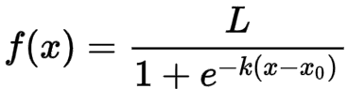
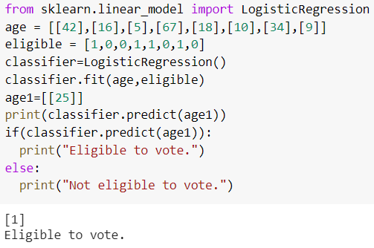
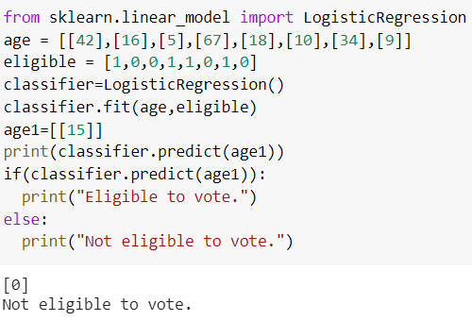
LOGISTIC REGRESSION
TYPES OF MACHINE LEARNING ALGORITHM
Logistic regression is a supervised learning algorithm which is mostly used for binary classification problems. The logistic function does the classification task in this algorithm. The logistic function is :
Program and output:

Slide 18
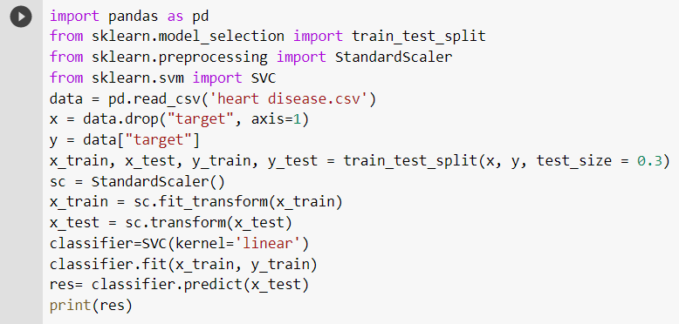
SUPPORT VECTOR MACHINE
TYPES OF MACHINE LEARNING ALGORITHM
Support Vector Machine (SVM) is a supervised learning algorithm and mostly used for classification tasks. Raw data is drawn on the n- dimensional plane. SVM distinguishes classes by drawing a decision boundary on the n-dimensional plane.
Program and output:

Slide 19
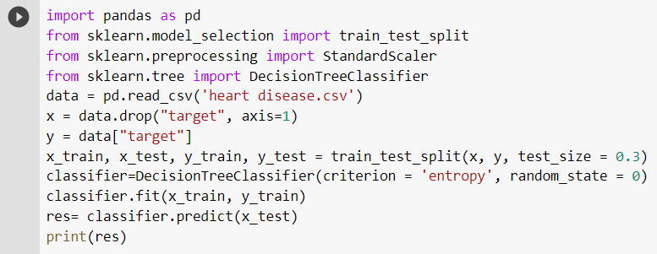
DECISION TREE
TYPES OF MACHINE LEARNING ALGORITHM
Decision Tree is a supervised learning algorithm. A decision tree builds upon iteratively asking questions to partition data. Splitting of data depends on the features of datasets. This process is done until the whole data is classified and we find leaf node at each branch.
Program and output:

Slide 20
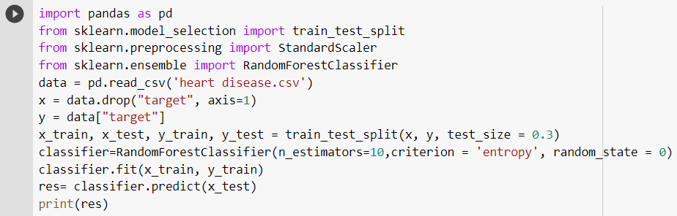
RANDOM FOREST
TYPES OF MACHINE LEARNING ALGORITHM
Random forest is a supervised classification algorithm. Multiple number of decision trees taken together forms a random forest algorithm. If used for a classification problem, the result is based on majority vote of the results received from each decision tree. Random forest regression takes mean value of the results from decision trees.
Program and output:

Slide 21
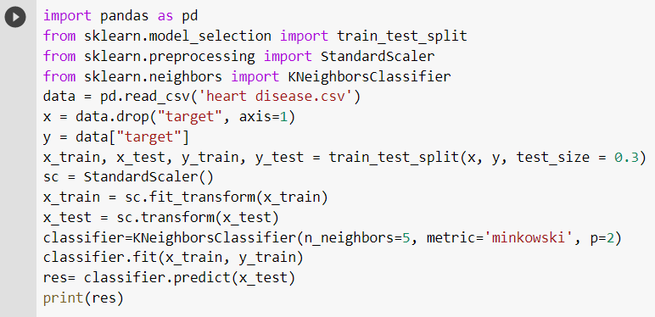
K NEARNEST NEIGHBORS
TYPES OF MACHINE LEARNING ALGORITHM
K-nearest neighbors (KNN) is a supervised learning algorithm that can be used to solve both classification and regression tasks. The main idea behind KNN is that the value or class of a data point is determined by the data points around it.
Program and output:

Slide 22
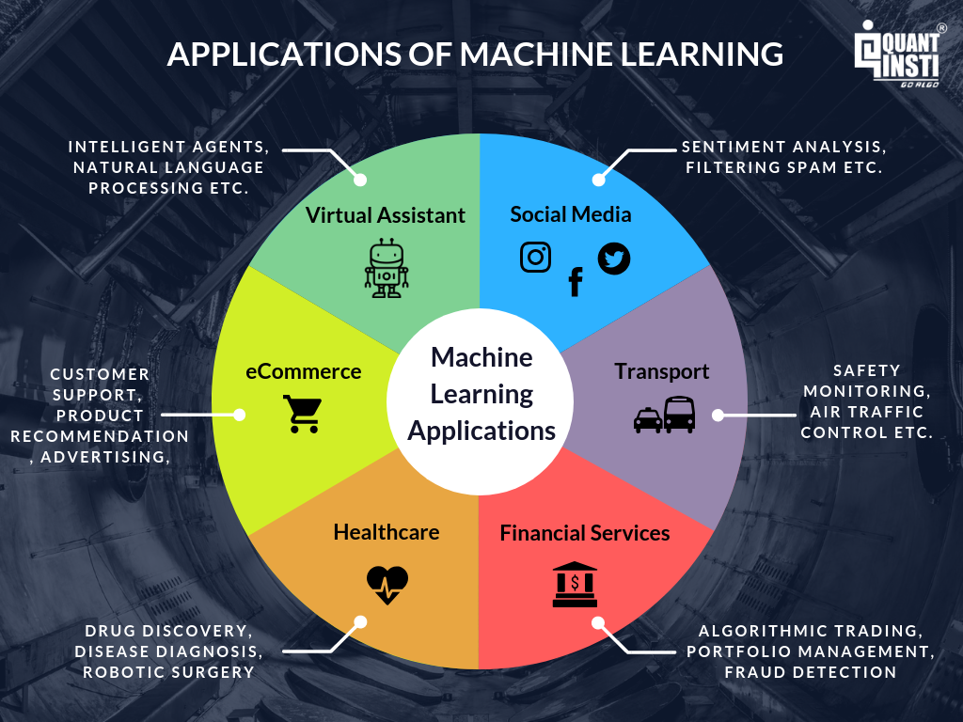
APPLICATIONS OF MACHINE LEARNING

Slide 23
APPLICATIONS OF MACHINE LEARNING
Applications is healthcare:
Drug discovery
Personalized Medicine
Smart health records
Disease diagnosis
Applications in farming:
Crop Yield Prediction
Smart irrigation systems
Soil monitoring
Weather monitoring
Applications in Telecom:
Performance Monitoring
Error Detection
Chatbot
Fraud Detection
Applications in transport:
Self Driving Cars
Safety monitoring system
Traffic management systems

Slide 24
REFERENCES
https://towardsdatascience.com/11-most-common-machine-learning-algorithms-explained-in-a-nutshell-cc6e98df93be
https://machinelearning-blog.com/
https://www.analyticssteps.com/blogs/introduction-machine-learning-supervised-and-unsupervised-learning
https://training.galaxyproject.org/training-material/topics/statistics/tutorials/classification_regression/tutorial.html
https://www.guru99.com/unsupervised-machine-learning.html
https://www.analyticssteps.com/blogs/6-major-branches-artificial-intelligence-ai

